Slide 1


SAP BTP Training
Cloud Foundry Training

Slide 2

DISCLAIMER
The training content and delivery of this presentation is confidential, and cannot be recorded, or copied and distributed to any third party, without the written consent of Anubhav Trainings

Slide 3

LEARNING OBJECTIVES
Bind to backing service
Backing service overview and binding
Eclipse link library and Steps
Deploy and test CF app
--BREAK--
Share and CI/CD
Understanding git integration from STS
Setup and build Jenkins pipeline

Slide 4



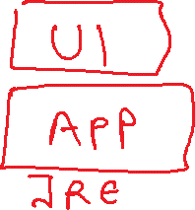



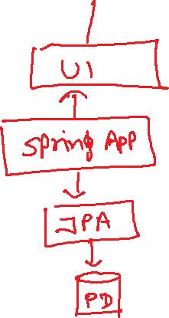
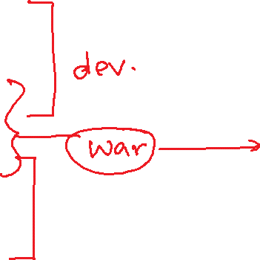






Slide 5
Backing Service in CF
A backing service in CF is just a reusable service. We will use these backing service for different purpose
DB as a service – PosgreSQL, SAP HANA, SAP HANA HDI, Mongo, Redis
Queue – Rabbit MQ, Kafka
Authentication manager – UAA service
Connectivity Service
Our application will bind to these services and use them out-of-box. As a app developer we don’t have to worry about running most of these functionalities own our own.
Steps:
Start a new backing service instance
In order to access these backing service we need add a services entry in our app’s manifest.yml file
The cloud foundry also provides Environment variables, which we can use to connect to these backing service. This way its fully flexible. To check these environment variables we can use command cf env <appname>
Advantage:
Never need to hardcode our db credentials anywhere, the app will look for it and connects to it
Scale backing service individual
Complete management of backing service using CF cockpit or command line
Take care of auto binding in D, Q and Production
www.anubhavtrainings.com

Slide 7
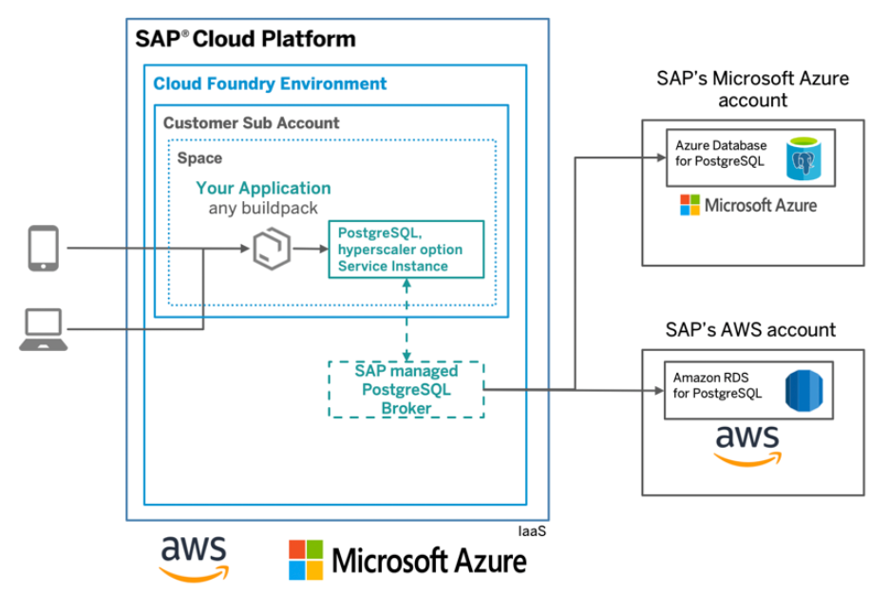
HANDS-ON: Setup Postgre Backing service in CF
SAP BTP

Slide 8
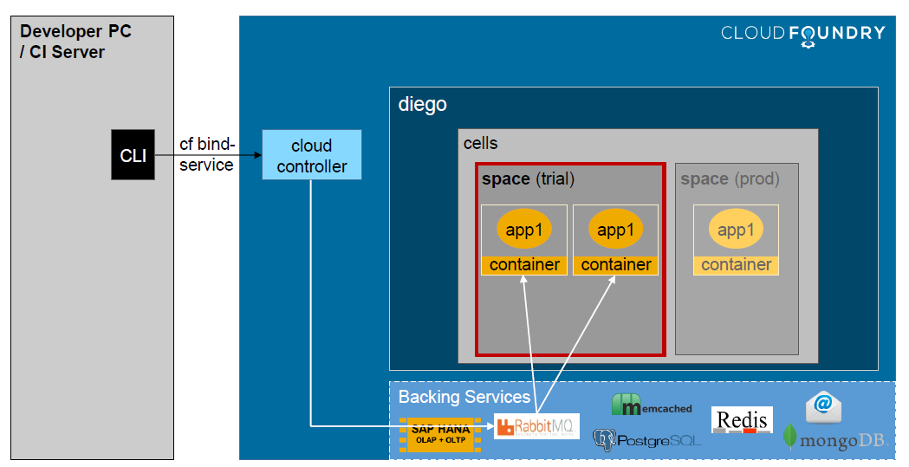
Backing Service Overview - Binding
www.anubhavtrainings.com

Slide 9
Steps
Create a new instance of backing service – Postgre
Add an entry for that backing service in our manifest.yml
Delete the properties file which has hardcoding of DB connection
Add new dependencies in our project
Spring-cloud-cloudfoundry-connector
Spring-cloud-spring-service-connector
Ngbc – DB Driver
Dbcp2
Org.eclipse.persistence.jpa
Implement 2 classes
Database Config class as described above, This class will use the variables to create a new data source connection. This data source connection will be passed to Spring JPA. Spring JPA needs EntityManager (Create, Alter DB Tables) and Transaction Manager(To CRUD). This class has 3 methods
Create a DB Connection
Create EntityManager by using our own DB Connection
Create Transaction Manager by using our own connection
Entity Manager class which will have all the settings and address of our entity classes.
We can change settings if we want into the EntityManager Factory.
Build project – skip test
Looking in CF environment a variable with name VCAP_SERVICES and parse it. Pass this information to a configuration class which we will register with spring. The class must inherit AbstractCloudConfig
Pool the connections and control the flow of calls to avoid flood to DB. Good for performance.
EclipseLink is a JPA implementation, which is responsible for creating EM, TR
www.anubhavtrainings.com

Slide 10
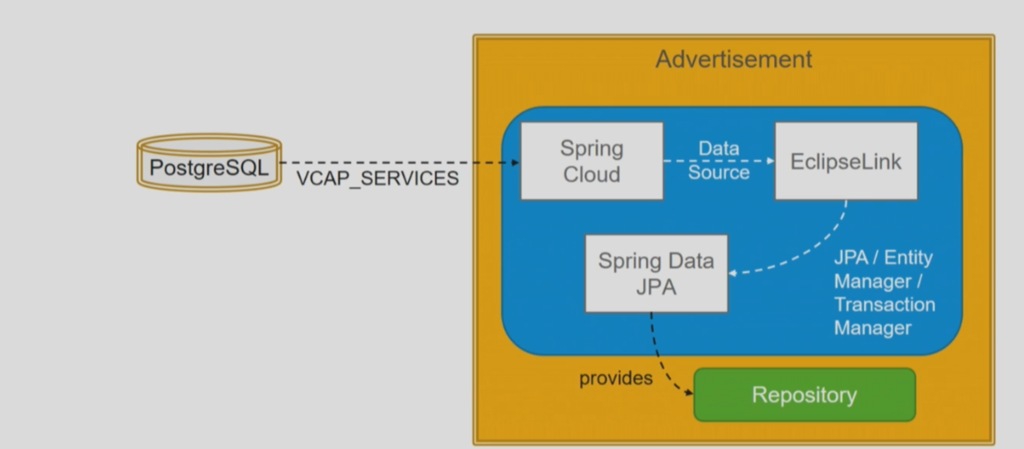
Access Environment Va riable - Postgre
www.anubhavtrainings.com

Slide 11
Using Git
Central place where everyone can put their code which can be shared across
Think of resolving conflict and blame in case there is something wrong in the code
We need a local version control @ developer’s local machine
Project
push
A
Local git Repository
Git HUB
(Internet)
pull
Project
Remote Repository
B
Local git Repository
https://git-scm.com/downloads
www.anubhavtrainings.com

Slide 12
Terminologies
Git commit – A save point which creates a stable version in git version control. We can always rollback our code to this stable version. When we do a git commit, we will do it on a local repository.
Branch – Collection of commits together creates a branch. Also allows us to maintain multiple versions of same application like 1.0, 2.0, dev, production, hotfix, dev
Vendor Git
Own Git
www.anubhavtrainings.com

Slide 13

Cloud Development Char.
Faster Innovations
Lower TCO
Value to time
Scalability
DEVOPS
CD – Continuous Delivery
Jenkins
Git
maven
CF
gitHUB
Maven Build
CF CLI
cf push
CF
push
war
www.anubhavtrainings.com

Slide 14
Steps
Steps
Download and install Jenkins https://www.jenkins.io/download/
Set JAVA_HOME, M2, M2_HOME, JENKINS_HOME Environment Variables
It will run automatically as a window service on port 8090 - http://localhost:8090/
Default user and password is admin / admin
Go to manage Jenkins → Manage Plugins
Maven Integration plugin
GitHub
Cloud Foundry Plugin
www.anubhavtrainings.com

Slide 15

Summarize
LET’S SUMMARISE!

Slide 16

Summarize
End of Day 6

Slide 18


We’re committed to empower you to be
#FutureReady
through powerful training solutions.
We build the workforce of the future.
250+
Corporate Clients
30,000+
Learners Trained
25000+
Learners Placed
FREE WEBINARS
Sign up for free webinars with industry experts every fortnight!
Enroll Now!
Contact us today!
https://anubhavtrainings.com

